Slide 1
Machine Learning
Machine Learning Introduction to Machine Learning by Kumar Anurupam is licensed under a Creative Commons Attribution-4.0 International License.
Decision Tree Classification – Model Selection
CS 3104 Fall 2019
Lecture Slides by Kumar Anurupam

Slide 2
Learning Objectives
After completion of today’s session you will be able to:
Explain imputation and instability
Elaborate the concept of Cross Validation

Slide 3
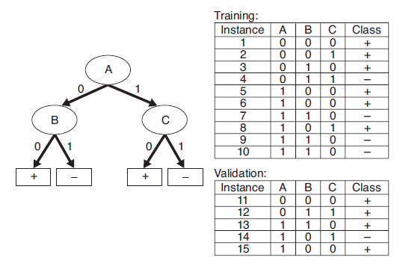
Example
Calculate the generalization error rate of the tree using:
1. Optimistic Approach
Ans. 5/10 = 0.5
2. Pessimistic Approach (Penalty = 0.5)
Ans. (5 + 4 x 0.5)/10 = 0.7

Slide 4
Comparison of Decision Tree Algorithms

Slide 5
Imputation
Imputation is the process of replacing missing data with substituted values.
There are two basic ways to perform imputation:
Single Imputation
Multiple Imputation
Single Imputation:
Deletion: Delete the records having missing value.
Hot Deck: A missing value is imputed from a randomly selected similar record.
Cold Deck: Selects values from another dataset.
Mean Substitution: Replacing any missing value with the mean of that variable for all other cases.
Regression: A regression model is estimated to predict observed values of a variable based on other variables, and that model is then used to impute values in cases where the value of that variable is missing.
Last observation carried forward: Involves sorting a dataset according to any of a variables, thus creating an ordered dataset. the first missing value is replaced by the cell value immediately prior to it.

Slide 6
Imputation – contd…
Multiple Imputation: In order to deal with the problem of increased noise due to imputation, Rubin (1987) developed a method for averaging the outcomes across multiple imputed data sets to account for this.
All multiple imputation methods follow three steps.
Imputation – Similar to single imputation, missing values are imputed. However, the imputed values are drawn m times from a distribution rather than just once. At the end of this step, there should be m completed datasets.
Analysis – Each of the m datasets is analyzed. At the end of this step there should be m analyses.
Pooling – The m results are consolidated into one result by calculating the mean, variance, and confidence interval of the variable of concern.

Slide 7
Instability
The instability problem of decision tree classification algorithms is that small changes in input training samples may cause dramatically large changes in output classification rules.
Decision trees can potentially be unstable if there is a small variation in the data that may result in a completely different tree being generated.
We can combat this by using a variety of ensemble methods such as bagging, boosting etc.

Slide 8
Model Selection Method – Cross Validation
It is a model validation techniques for assessing how the results of a statistical analysis (model) will generalize to an independent data set.
It is mainly used in settings where the goal is prediction, and one wants to estimate how accurately a predictive model will perform in practice.
The goal of cross-validation is to define a data set to test the model in the training phase (i.e. validation data set) in order to limit problems like overfitting, underfitting and get an insight on how the model will generalize to an independent data set.
It is important the validation and the training set to be drawn from the same distribution otherwise it would make things worse.

Slide 9
Cross Validation Types
Some of the most commonly used methods in cross validation are:
Hold out Method
K-Fold Cross Validation
Leave one out Cross Validation
Bootstrap Methods

Slide 10
Hold Out Cross Validation
It is the simplest kind of cross validation.
The data set is separated into two sets, called the training set and the testing set.
The function approximator fits a function using the training set only.
Then the function approximator is asked to predict the output values for the data in the testing set.
The errors it makes are accumulated as before to give the mean absolute test set error, which is used to evaluate the model.
One disadvantage of this method is that it is prone to sample bias because we don’t decide which observation will be in training sample and which in testing sample.

Slide 11
K-Fold Cross Validation
It is one way to improve over the holdout method.
The data set is divided into k equal size subsets.
Each time, one of the k subsets is used as the test set and the other k-1 subsets are put together to form a training set.
Then the average error across all k trials is computed.

Slide 12
K-Fold Cross Validation – contd…
The advantage of this method is that it matters less how the data gets divided. Every data point gets to be in a test set exactly once, and gets to be in a training set k-1 times. The variance of the resulting estimate is reduced as k is increased.
Also no sample bias is present.
The disadvantage of this method is that the training algorithm has to be rerun from scratch k times, which means it takes k times as much computation to make an evaluation.
Prediction error = Average error

Slide 13
Leave one out Cross Validation
It is K-fold cross validation taken to its logical extreme, with K equal to N, the number of data points in the set.
That means that N separate times, the function approximator is trained on all the data except for one point and a prediction is made for that point.
As before the average error is computed and used to evaluate the model.
Its advantage is that it is a good way to validate.
Disadvantage is the high computation required.

Slide 14
Bootstrap Method
From a dataset with N examples
Randomly select (with replacement) N examples and use this set for training
The remaining examples that were not selected for training are used for testing
This value is likely to change from fold to fold
Repeat this process for a specified number of folds (K)
As before, the true error is estimated as the average error rate on test examples

Slide 15
References
[1] Tan, ©., & Steinbach (2004). Data Mining Classification : Basic Concepts , Decision Trees , and Model Evaluation.
[2] https://en.wikipedia.org/wiki/Imputation_(statistics)
[3] https://www.cs.cmu.edu/~schneide/tut5/node42.html
[4] https://towardsdatascience.com/cross-validation-70289113a072

Slide 16
Thanks

